Slide 1
Configuring and Administrating SharePoint Server 2010
Notes:
The module explores the Central Administration Web Site and discusses how to configure SharePoint Server 2010 after initially creating a new farm. You will learn how to leverage Managed Service accounts and how to configure and schedule timer jobs . The module discusses when to use and when to not to use the Farm Configuration Wizard. The lecture and lab will show you how to create new service application instances by hand for scenarios where using the Farm Configuration Wizard is not appropriate.

Slide 2
Agenda
Getting Around in Central Administration
Managed Service Accounts
Managing Timer Jobs
Using the Farm Configuration Wizard
Configuring Service Applications by Hand

Slide 3
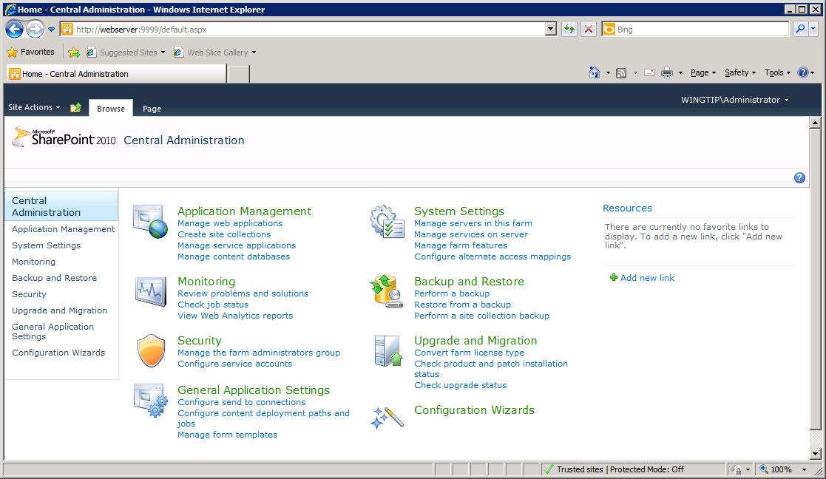
Central Administration
Site for Administrators to make farm wide settings
Home page has sections broken out by functionality
Notes:
This is the home page of the SharePoint 2010 Central Administration. It contains links to different administration pages, divided in sections by functionality.
Each section title is also a link which brings you to another page containing links again divided in sections by functionality.
You also find the section titles in the Quick Launch on the left of the page.

Slide 4
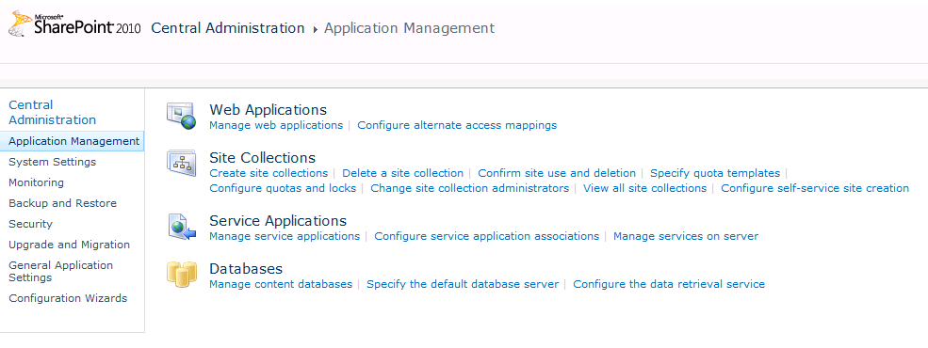
Application Management
Top-level manage of applications and content
Web Application
Site Collections
Service Applications
Content Databases
Notes:
The Application Management page contains different sections to manage web applications, site collections, service applications and content databases.

Slide 5
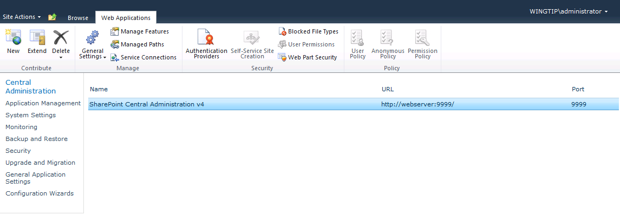
Web Application Management
Web application page allows you to…
Inspect and configure existing Web applications
Create new Web applications
Web Application for Central Administration is created when farm is created
Notes:
The Manage web applications hyperlink brings you to a page where you can manage existing web applications and create new web applications The page contains a contextual ribbon .

Slide 6
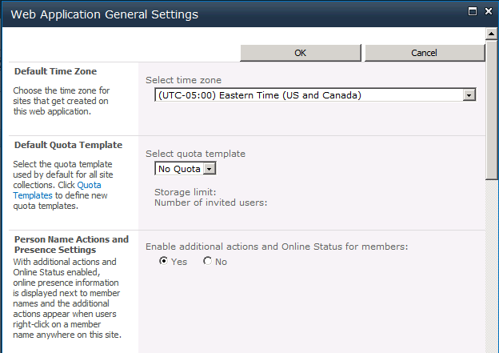
Web Application – General Settings
Web Application has General Setting dialog
Allows you to configure many different settings
Notes:
When you select the General Settings button on the ribbon you get a dialog where you can view and/or modify the general settings of the selected web applications.
Settings you can view/modify are:
Default Time Zone
Default Quota Template
Person Name Actions and Presence Settings
Alerts
RSS Settings
Blog API Settings
Browser File Handling
Web Page Security Validation
Send User and Password in E-mail
Master Page Setting for Application _Layouts Pages
Recycle Bin
Maximum Upload Size

Slide 7
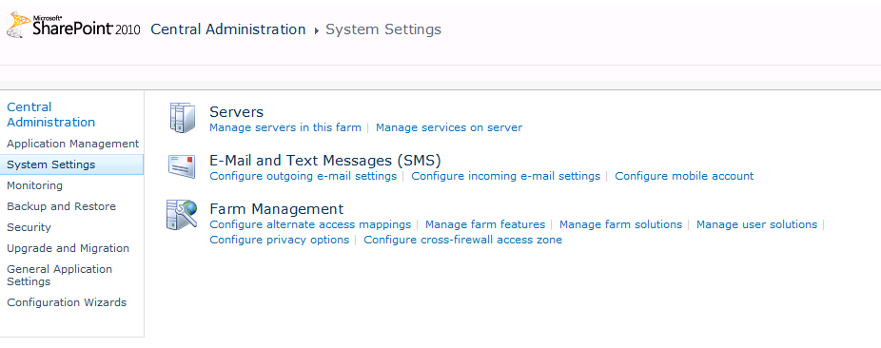
System Settings
System Settings page allows you to…
Inspect and configure servers in farm
Inspect, configure and create application services
Configure farm e-mail settings
Navigate to other farm management pages
Notes:
The System Settings page allows you to manage servers in the farm, application services, e-mail settings, configure alternate access mappings, manage farm features, farm solutions, user solutions.
Also here the page is divided into sections based on functionality.

Slide 8
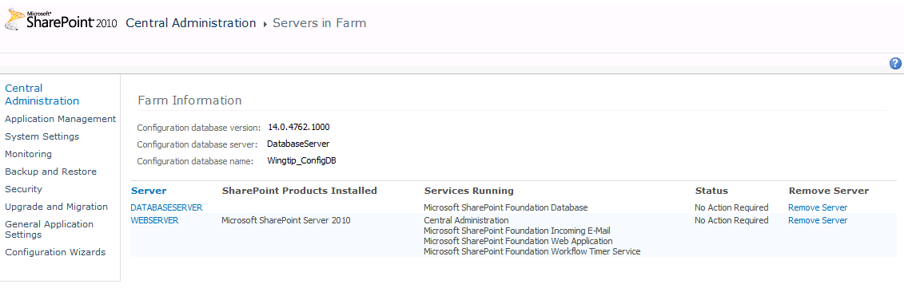
Servers in Farm
Servers in Farm page allows you to see…
Database Server(s)
Web Server(s)
Application Server(s)
Notes:
Clicking the Manage servers in this farm hyperlink brings you to a page where you can view and manage all the servers that make up the SharePoint farm. Click the hyperlink with the server name brings you to a page with more detailed information about the server. You can also remove a server from the farm.

Slide 9
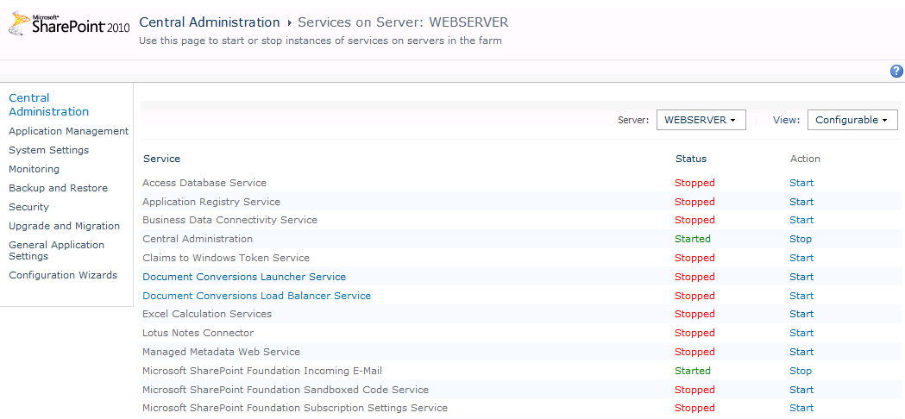
Services on Server
SharePoint Server 2010 installs many services
Complete install adds services for Web server(s)
Complete install adds services for Application server(s)
Many of the services provided must be configured
Many (but not all) services list here are service applications
Notes:
Clicking the Manage services on server hyperlink on the System Settings page, brings you to this page where you can see which services are installed on the server. From here you can start and stop services.
When configuring the SharePoint 2010 Central Administration (after the SharePoint 2010 Configuration wizard ran successfully, you can choose to install all services or only a few of them. It is better to install only those you need from the beginning and install other services when needed.

Slide 10
Email Servers
Outgoing email – Any SMTP Server
Common issues:
Port 25 is blocked (some AV products do this)
Relaying is prohibited on the email server
Incoming email
Receive email and route to document libraries
Requires: Installing SMTP service on SP server
Integrates nicely with Exchange Server
Notes:
For more information and step by step for configuring Incoming email with Exchange 2003 or Exchange 2007 check out http://www.combined-knowledge.com/Downloads%202007.htm
More details about Incoming Email feature http://technet2.microsoft.com/windowsserver/WSS/en/library/ac36dcfa-d3ac-4269-934d-4e52a1df5e141033.mspx?mfr=true

Slide 11
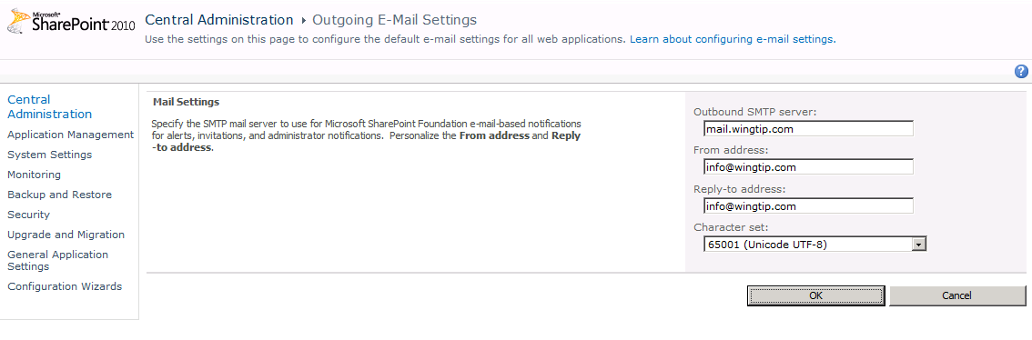
Set Outgoing Email
SharePoint relies on Outbound SMTP server
Used to send automated email messages
Set up server to allow relay from SharePoint’s IP
Ensure no firewall is blocking port 25
Ensure antivirus software not blocking outbound
Notes:
Outgoing e-mail is the foundation on which site administrators can implement several e-mail notification features. These features help end users track changes and updates to individual site collections and allow site administrators to deliver status messages.
Properly configuring outgoing e-mail is a requirement for implementing e-mail alerts and notifications. The outgoing e-mail feature uses an outbound Simple Mail Transfer Protocol (SMTP) service to relay e-mail alerts and notifications. These e-mail features include alerts and administrative messages.

Slide 12
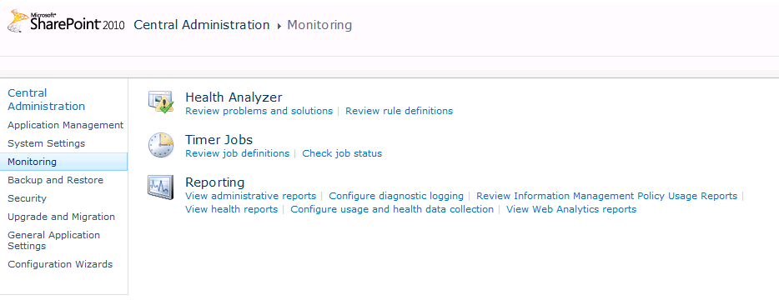
Monitoring
SPF provides built-in monitoring and reporting
Health Analyzer defines rules and displays warnings
Timer jobs used to schedule/run administrative tasks
Reports can be generated on traffic, usage and storage
Notes:
The Monitoring page is the starting point for the Health Analyzer, managing timer jobs and other reporting tasks.
Analyzing the health of your SharePoint farm has been drastically improved with SharePoint 2010. You can now manage your farm health from within SharePoint Central Administration. The Health Analyzer runs diagnostics on the system and compiles the results into a report.
Timer Jobs are used to schedule and run administrative tasks. The pages where you can manage the timer job definitions and view the status of running and finished jobs are drastically improved.
The Reporting section contains hyperlinks to pages where you can view and configure diagnostics logging and health reports.

Slide 13
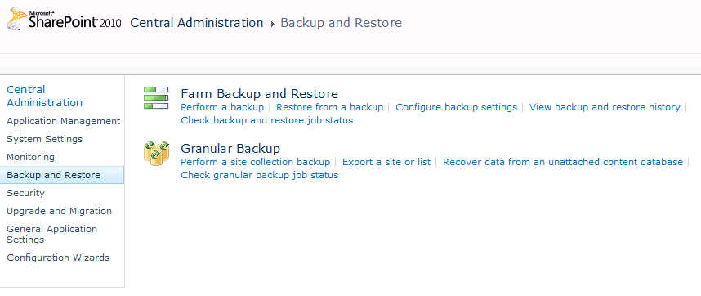
Backup and Restore
SharePoint 2010 enhanced backup capabilities
Backup/restore supported at farm level
Backup/restore supported at site collection level
Backup/restore supported at site and list
Much more detail to come on backup/restore in later lectures
Notes:
The backup and restore story as been greatly enhanced in SharePoint 2010. You can backup and restore at farm level and at site collection, but you can also perfrom more granular backups like backups at site and list level. You can even recover data from an unattached content database.

Slide 14
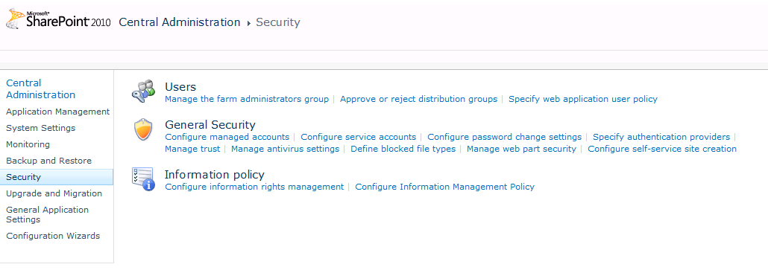
Security
Security pages to do the following
Add users to farm administrators group
Configure managed accounts
Define blocked file types
Configure trusts and authentication providers
Notes:
The Security page offers links to pages where you can manage the farm administrators, configure managed accounts, etc.

Slide 15
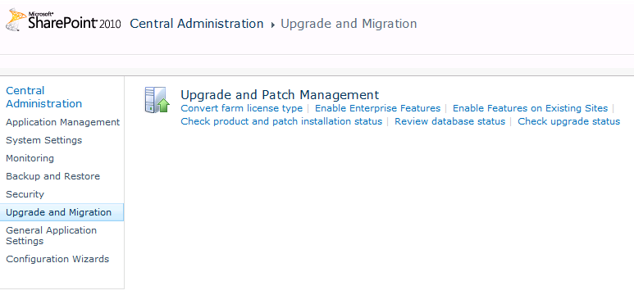
Upgrade and Migration
Upgrade and Patch Management
Upgrade from Standard CAL to Enterprise CAL
Manage patch installation
Notes:
From within the Upgrade and Migration page you can manage upgrades and patches. You can also upgrade your license type from here.

Slide 16
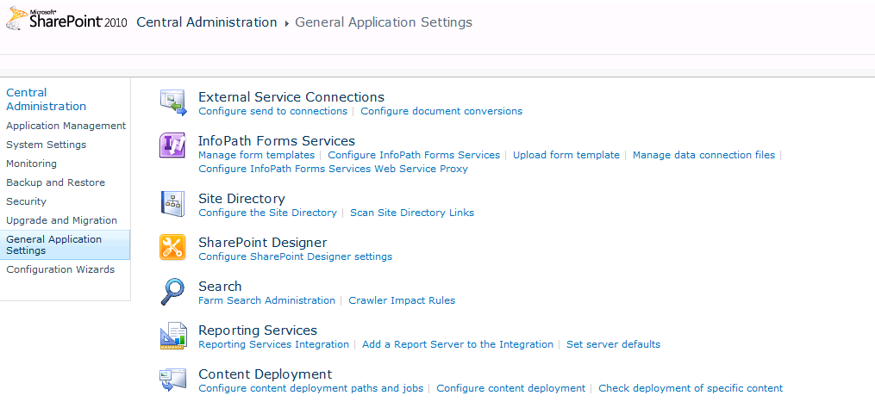
General Application Settings
General Settings
Configure InfoPath Forms Services
Configure SharePoint Designer Permissions
Navigate to Search Administration
Configure SQL Server Reporting Services integration
Notes:
The General Application Settings page allows you to configure settings like InfoPath Form Services, configure SharePoint Designer Permissions, configure SQL Server Reporting Services integration, manage content deployment.
You can also enter Search Administration from here.

Slide 17
DEMO
Tour of Central Administration

Slide 18
Agenda
Getting Around in Central Administration
Managed Service Accounts
Managing Timer Jobs
Using the Farm Configuration Wizard
Configuring Service Applications by Hand

Slide 19
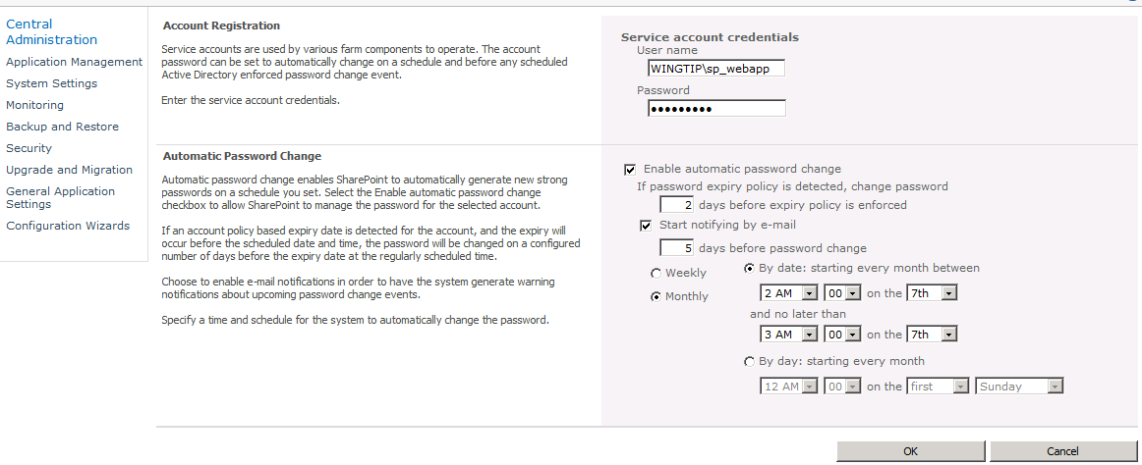
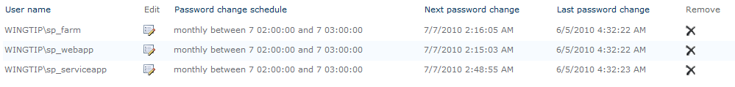
Managed Accounts
SPF allows you to register managed accounts
Provides assistance managing password changes
Create managed account for each Active Directory service account
Notes:
You need to register managed accounts with the farm to make the accounts available to multiple services. You can register a managed account by using the Register Managed Account page in the SharePoint 2010 Central Administration.
Use the Password Management Settings page of the SharePoint 2010 Central Administration to configure farm-level settings for automatic password changes. Farm administrators can configure the notification e-mail address that will be used to send all password change notification e-mails, as well as monitoring and scheduling options.

Slide 20
DEMO
Registering a Managed Account

Slide 21
Agenda
Getting Around in Central Administration
Managed Service Accounts
Managing Timer Jobs
Using the Farm Configuration Wizard
Configuring Service Applications by Hand

Slide 22
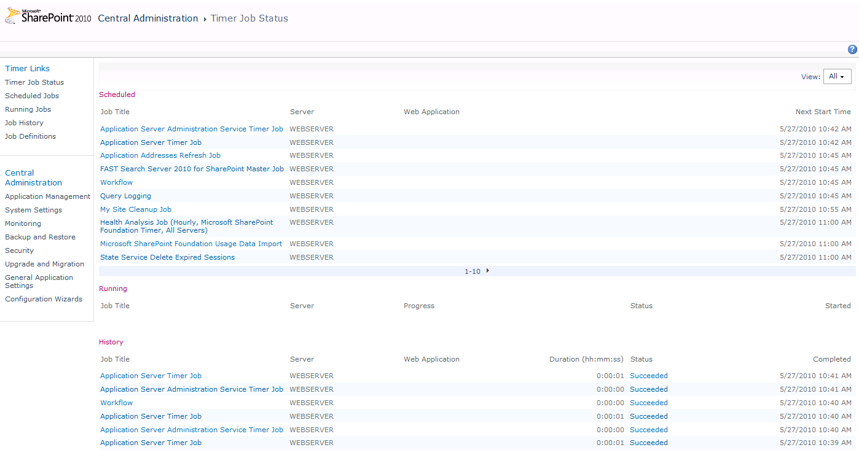
Timer Jobs
SharePoint Foundation supports timer jobs
Timer jobs used to automate administrative tasks
Job definition can be scheduled or run immediately
Job history shows what time jobs have runs
Notes:
Timer Jobs were already supported in SharePoint 2007 but the management of job definitions and timer jobs has been greatly enhanced in SharePoint 2010.
There are 20 new timer jobs:
Application Addresses Refresh Job
Audit Log Trimming
Delete Job History
Document ID enable/disable job
Document ID assignment job
Enterprise Server Search Master Job
Health Analysis Job
InfoPath Forms Services Maintenance
Password Management
Prepare query suggestions
Product Version Job
Query Logging
Secure Store Service Timer
Solution Daily Resource Usage Update
State Service Delete Expired Sessions
Timer Service Recycle
Web Analytics Trigger Workflows Timer Job
Windows SharePoint Services Usage Data Import
Windows SharePoint Services Usage Data Processing
Word Conversion Timer Job
Workflow

Slide 23
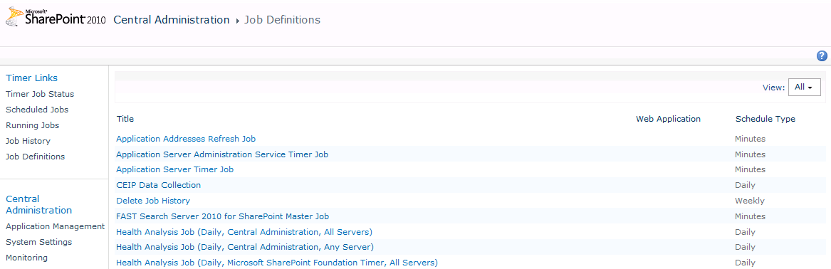
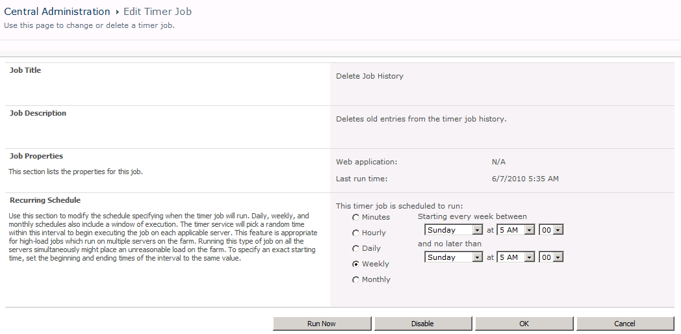
Timer Job Definitions
SharePoint 2010 provides built-in job definitions
You can run a job definition
You can configure scheduling of a job definition
You can disable a job definition
Notes:
When you open the Job Definitions page, you get a list of all job definitions. On top of the page you have two dropdowns that can help you filter the list of job definitions.
From here you can also manage the job definitions. The hyperlinked names of the job definitions bring you to the page where you can view and/or modify the schedule of the timer job.
Notice also the Timer Links section in the Quick Launch that allows you to manage all jobs from this single page, so you don’t need to navigate back to the Central Administration to switch to another page.

Slide 24
DEMO
Working with Timer Jobs

Slide 25
Agenda
Getting Around in Central Administration
Managed Service Accounts
Managing Timer Jobs
Using the Farm Configuration Wizard
Configuring Service Applications by Hand

Slide 26
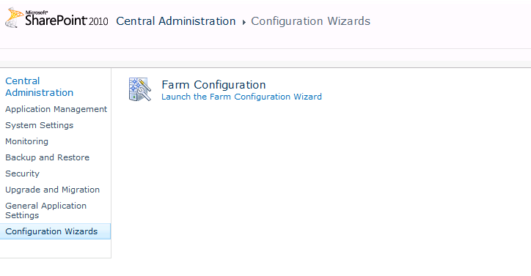

Configuration Wizards
SPF provides Farm Configuration Wizard
Informally known as the “White Wizard"
Automatically creates/configures service applications
Convenient for testing scenarios
Can be used in some but not all production scenarios
The alternative involves creating service applications by hand or using Windows PowerShell scripts
Just sit back and relax and let me take care of creating this farm's service applications
Notes:
You can launch the Farm Configuration Wizard from here. It helps you to create and configure the service applications.

Slide 27
Agenda
Getting Around in Central Administration
Managed Service Accounts
Managing Timer Jobs
Using the Farm Configuration Wizard
Configuring Service Applications by Hand

Slide 28
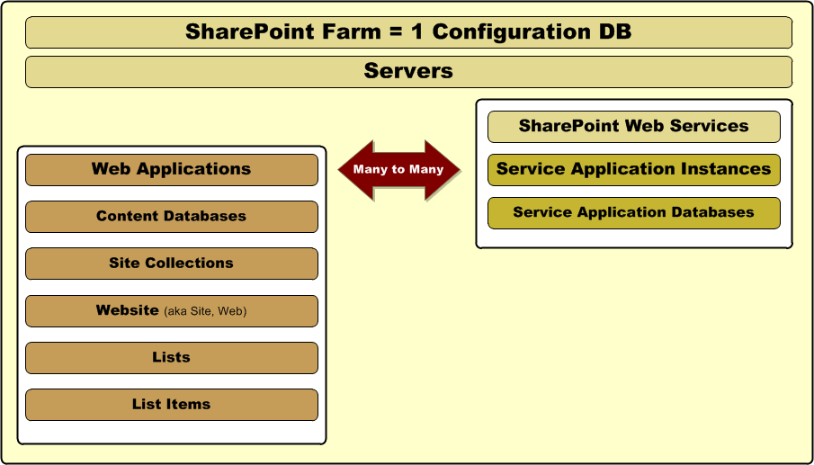
SharePoint Containment Hierarchy
Notes:
You saw this same diagram back in lecture 1. However, now we will concentrate what is on the right-hand side which is specific to the new service application architecture.
Each server running SharePoint Foundation is configured with an IIS Web site named SharePoint Web Services. Inside this IIS Web site there are Web service entry points for the service application that ship with SharePoint Foundation and SharePoint Server 2010.
It is important to distinguish between a service application entry point and a service application instance. For example, SharePoint 2010 creates service application entry points when you create a new farm. But creating a new farm does not automatically create service application instances for service applications such as Word Automation Services, Excel Services or the Managed Metadata Service. Instead, you must create service application instances as part of your initial farm configuration.
Also note that it is possible to create multiple instances of the same service application with a single farm. For example, you could create two instances of the Managed Metadata Service in the same farm which could be used by two different groups of users. Service application instances also get their own private database which are not shared with other service application instances.
There will be many service application instances per farm. Most service application instances have their own database. Although that is not always the case. Some service application instances have more than one database while other service application instances have no database at all.

Slide 29
Working with Service Applications
Not all service applications are created equal
Some (but not all) service apps have a database
Some (but not all) service apps can run on app server
Some (but not all) service apps work across farms
How do you create service application instance?
Create them using the White Wizard
Create them by hand in Central Administration
Create them using PowerShell scripting
Notes:
SharePoint 2010 offers a number of service applications. A service application provides a resource that can be shared across sites within a farm or, in some cases, across multiple farms.
In SharePoint Server 2010, services are no longer contained within a Shared Services Provider (SSP). Instead, the infrastructure for hosting services moves into Microsoft SharePoint Foundation 2010 and the configuration of the services is much more flexible. Individual services can be configured independently and third-parties can add services to the platform using the Application Service Framework.

Slide 30
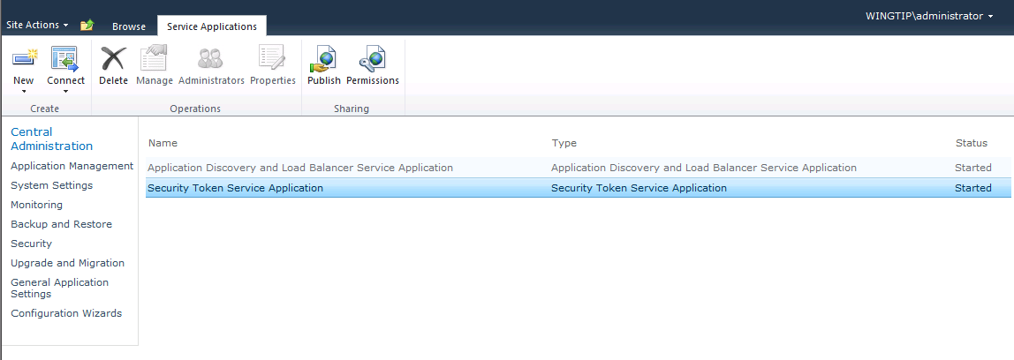
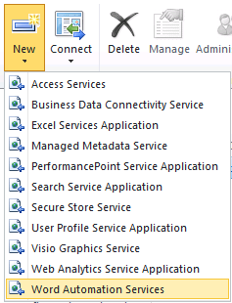
Creating Service Application Instances
Creating and managing service application instances
Two service application instances are created during SPF install these two service application instances cannot be modified
You can use New menu to create service application instances
Notes:
You can easily create and configure service application instances using the SharePoint Central Administration. Click the New button and select the service for which you want to create a new service application instance.

Slide 31
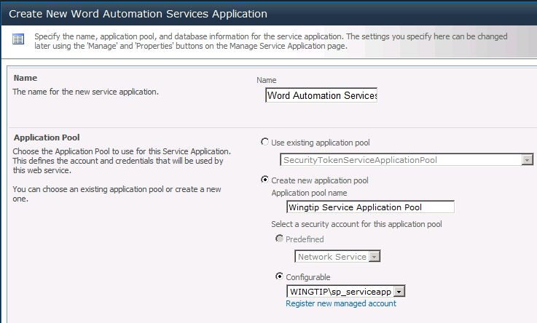
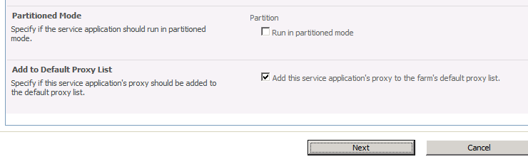
Creating a Service Application Instance
Create new service application using New menu
Dialog appears for you to fill in details of creation
Notes:
Based on the service application instance you choose, you will be presented with a page where you can configure the different settings, like databases, managed accounts. Each type of service application has its own set of settings.

Slide 32
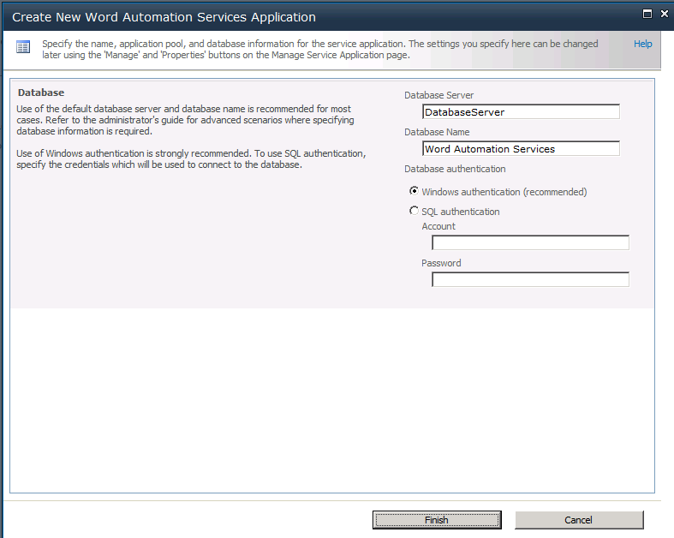
Service Application Database Creation
Database created along with service application
Farm account (sp_farm) configured as dbowner
App Pool account (sp_serviceapp) also configured as dbowner
Notes:
Most of the service applications create their own database. This means that the farm administrator account gets configured with the dbowner role. You can choose to run all service applications under the same application pool, or under a new application pool. The application pool account is also configured on the database with the dbowner role.

Slide 33
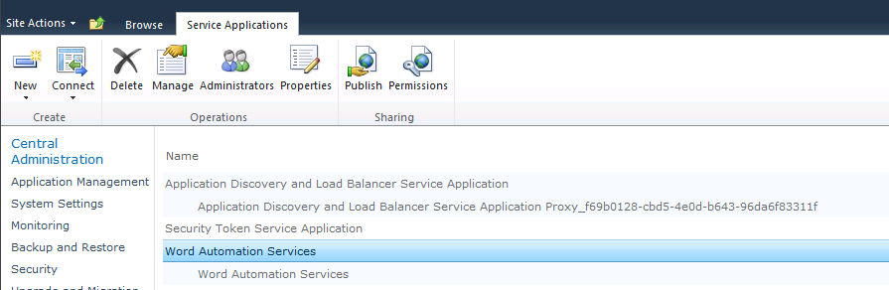





Service Application Management
Use ribbon buttons to configure service applications
navigate to main administrative page for service application
set who can administrate/configure this service application
view and modify properties such as database location
configure service application for access by other farms
configure which users can use this service application
Notes:
The Service Applications page is accessible from SharePoint Central Administration > Application Management > Manage service applications. This page lists all service applications instances. Clicking the hyperlinked name of the service application brings you to a page where you can manage the service application instance. You can highlight the service application instance by clicking on the row of the service application instance. Once the instance is hightlighted, you can use the buttons on the ribbon to configure additional settings like administrators and permissions.

Slide 34
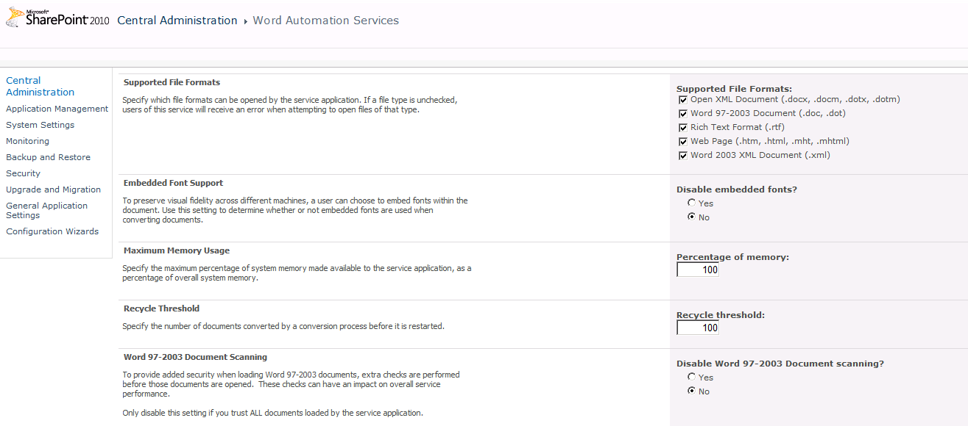
Configuring Service Applications
Manage button navigates to main admin page
This is main place to configure service applications
Each service application has its own custom settings
Notes:
There are 2 possible ways to navigate to the configuration page of the service application:
Clicking the hyperlinked name of the service application, or
Selecting the line of the service application and click the Manage button on the ribbon.
The different sections on this configuration page are different for each service application.

Slide 35
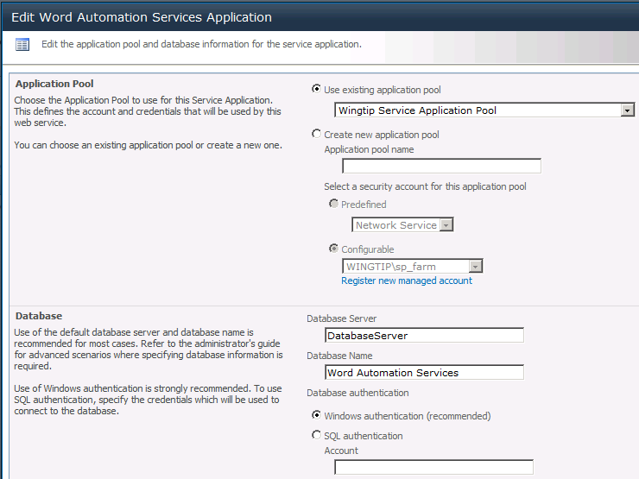
Service Application Properties
Used to configure app pool and database settings
Notes:
The Propertiesbutton brings you to the page where you can view and manage the service application properties. These properties are the application pool and database settings.

Slide 36
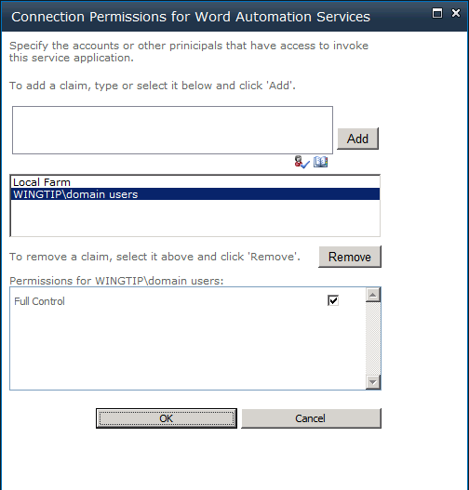
Configuring User Permissions
You must configure service app permissions
By default, users have no permissions for access
Notes:
The Permissions button brings you to the page where you can manage the permissions for the service application. By default, users have no permissions for access.

Slide 37
Delegated Administrators
Service applications can have their own security
You can give a user admin access to the SA without giving them any other access to CA.
They get a security trimmed UI
Some services have their own additional specialized admin roles
Notes:
Service applications can have their own security. Farm administrators can delegate administration of a specific service application (like the User Profile service application, or the Managed Metadata service application) to a service application administrator. A service application administrator can perform all of the administrative tasks related to that service application, but cannot manage other service applications or settings contained in the SharePoint Central Administration.

Slide 38
Summary
Getting Around in Central Administration
Managed Service Accounts
Configuring Timer Jobs
Using the Farm Configuration Wizard
Configuring Service Applications by Hand

